Slide 1
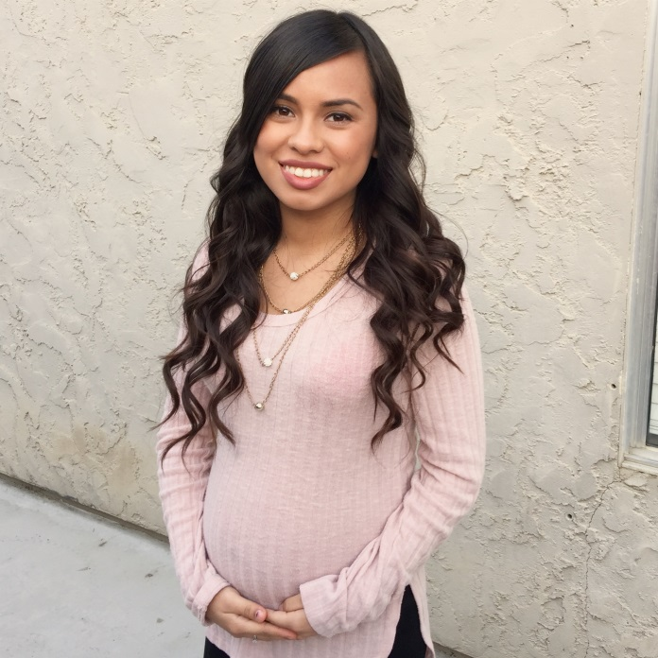
Senior Exit Interview
Deysi Corona Lemus

Slide 2
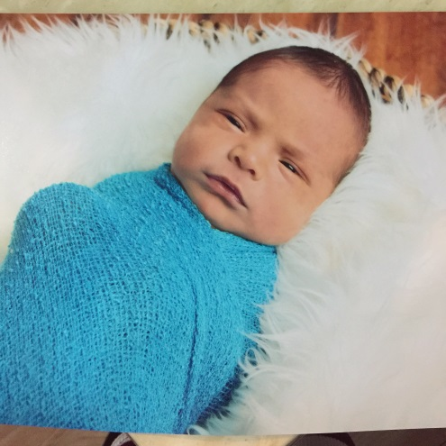
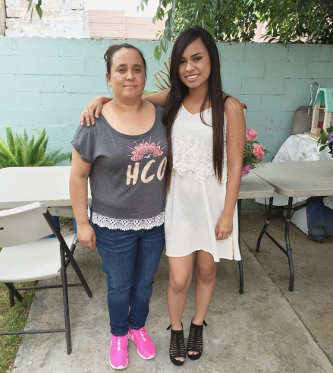
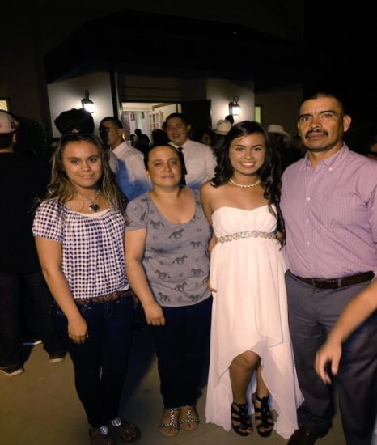
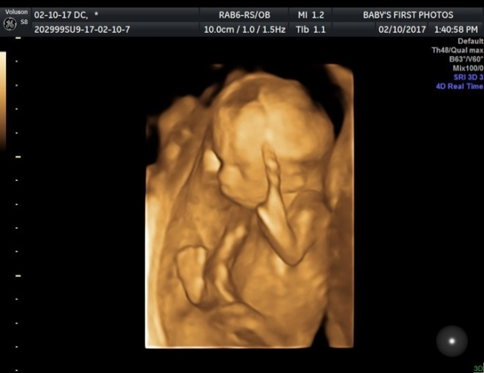
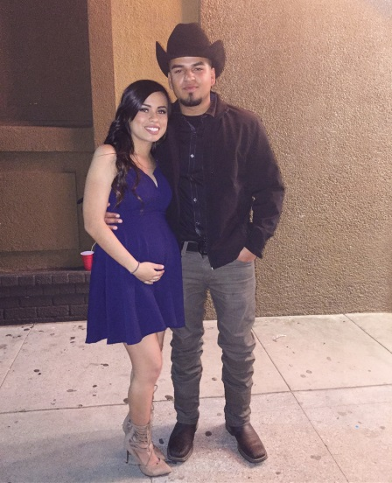
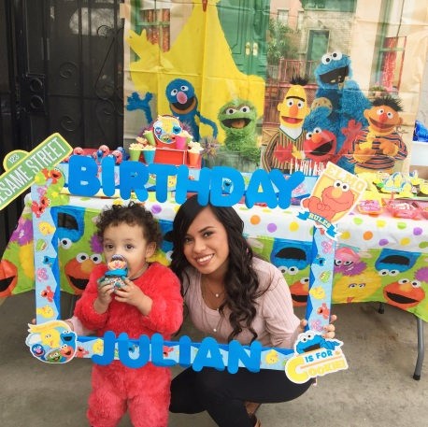
About Me
I was born in Puruandiro Michoacan, Mexico in 1998
I have an older sister and a baby brother
Jobs
McDermont Field House
Fields
My parents are both field workers
Personal Challenge: Finding out I was pregnant

Slide 3
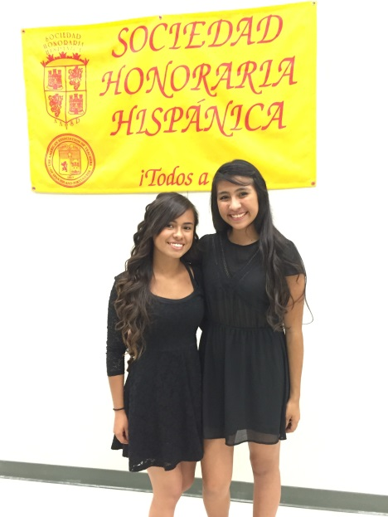
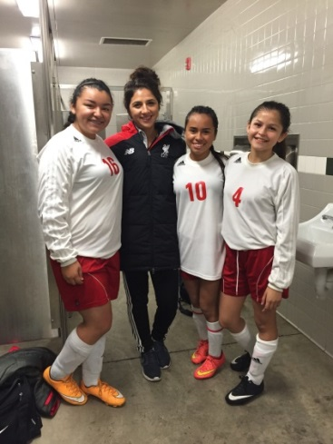
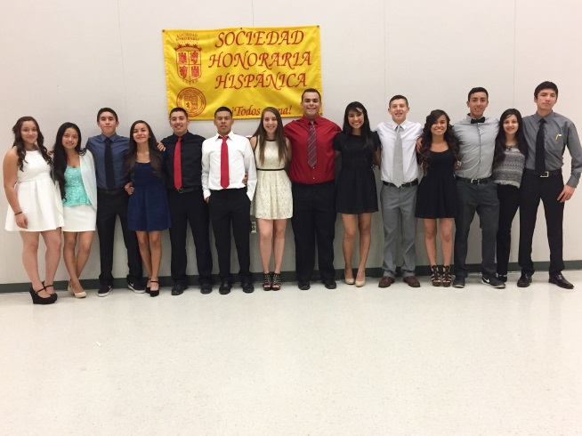
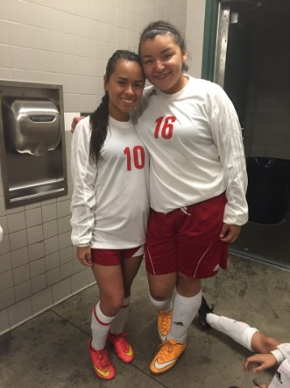
High School Experience
Clubs
Spanish Honors Society
My Voice Club
Art Club
Soccer
Personal Challenge: Finding out I was pregnant made me
miss a lot of school and fall behind in my classes
Something I learned about myself is not to give up when
I’m almost there and keep on trying to do better for my little one

Slide 4
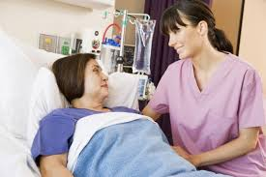
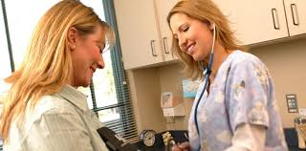
Job Shadow
I Job Shadowed Dora Espinoza from Sierra Valley Rehab Center in Porterville
Communicating and understanding some patients is a tough job
It takes a lot of patience to understand your patients and your co-workers in order to perform your job the right way
I definitely will pursuit this career

Slide 5
Pathway
My pathway in high school was Spanish
I choose this as my pathway because I wanted to improve my language
This will benefit me in my future and in my job
It’s tough me that you never finish learning in life new things

Slide 6
Post-High School Plans
Plan A
Attend to Porterville College for a year
Be a full time student
Receive my certificate
Licensed Vocational Nurse
Plan B
Go back to Porterville College in 3 years
Receive my associates
Enroll in RN Programs
Receive my Bachelor's Degree in Nursing
Registered Nurse

Slide 7
Leaving LHS
Thank you to all my teachers for always pushing me to not give up
I’m very thankful I spent my 4 years at this school
I learned how to stay on pace and take advantage of my time

Slide 8
Thank You For Your Attention
Any Questions?

